Slide 1
Flight Price Prediction
Atharva Ramesh shelar

Slide 2
Problem Statement
Introduction
EDA
Model Evaluation
Conclusion

Slide 3
Problem Statement
Anyone who has booked a flight ticket knows how unexpectedly the prices vary. The cheapest available ticket on a given flight gets more and less expensive over time. This usually happens as an attempt to maximize revenue based on -
1. Time of purchase patterns (making sure last-minute purchases are expensive)
2. Keeping the flight as full as they want it (raising prices on a flight which is filling up in order to reduce sales and hold back inventory for those expensive last-minute expensive purchases)
So, you have to work on a project where you collect data of flight fares with other features and work to make a model to predict fares of flights.

Slide 4
Introduction
The airline companies are considered one of the mostEnlightened industries use complex methods and complex strategies to allocate airline prices in a dynamic fashion. These industries are trying to keep their all-inclusive revenue as high as possible and boost their profit. Customers are seeking to get the lowest price for their ticket. while airline companies are trying to keep their overall revenue as high as possible and maximise their profit. However, mismatches between available seats and passenger demand usually lead to either the customer paying more or the airline company losing revenue. Airline companies are generally equipped with advanced tools and capabilities that enable them to control the pricing process. However, customers are also becoming more strategic with the development of various online tools to compare prices across various airline companies. In addition, competition between airlines makes the task of determining optimal pricing difficult for everyone.

Slide 5
EDA

Slide 6
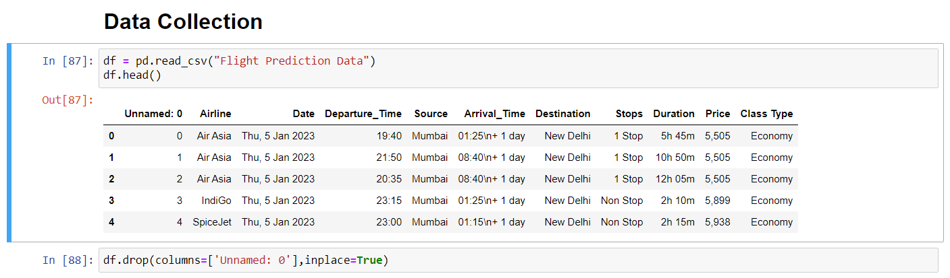
Dataset Information
Using Selenium, data from yatra.com is scraped from January 6, 2023, to January 12, 2023. Data is scraped for the Mumbai-Delhi flight in economy class, business class, and premium economy class. Around 2000 flight data are collected.

Slide 7
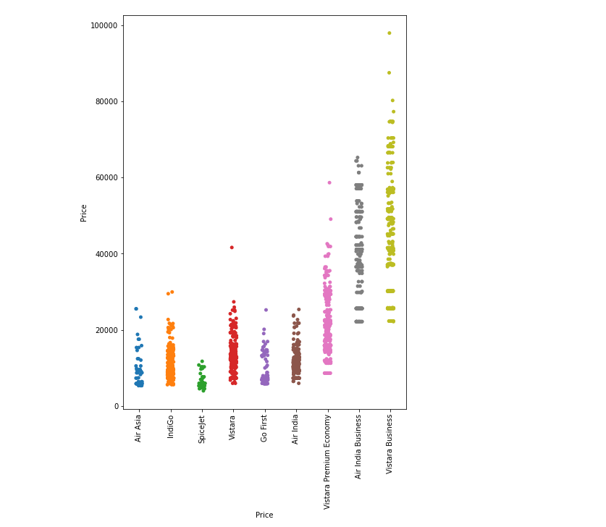
Airline
Vistara Premium Economy 352
Vistara Business 300
Vistara 278
IndiGo 271
Air India Business 263
Air India 233
Go First 112
Air Asia 62
SpiceJet 34

Slide 8
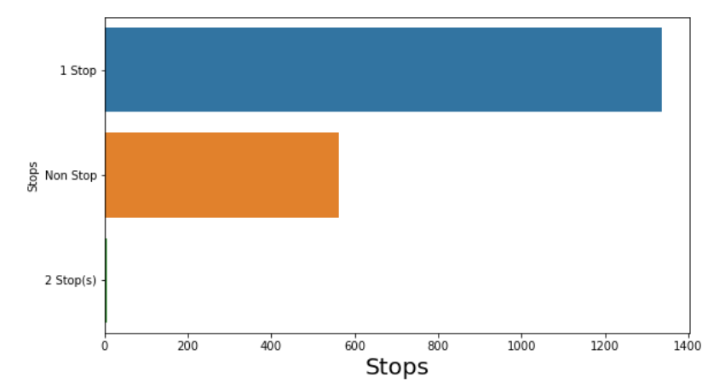
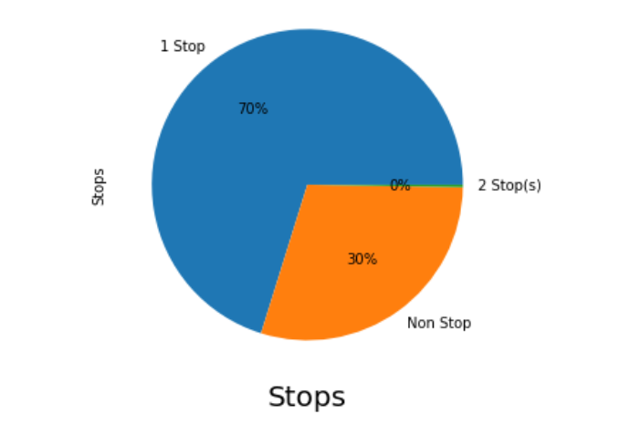
Stops
1 Stop 1337
Non Stop 563
2 Stop(s) 5

Slide 9
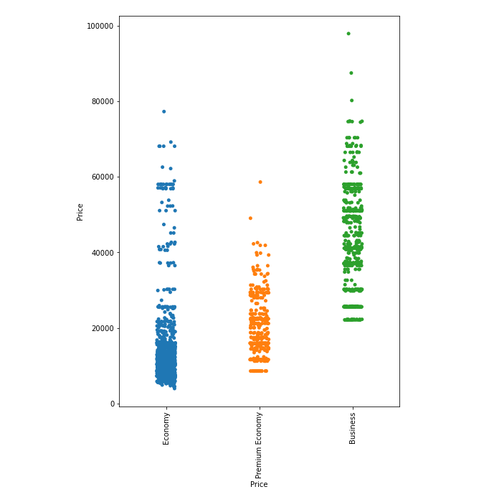
Class Type
Economy 1070
Business 483
Premium Economy 352

Slide 10
Vistara business, air India business, and Vistara premium economy are the most expensive airline companies.
Spicejet is the cheapest airline company.
A one-stop flight is more expensive than a nonstop flight.
Most flights are one-stop and nonstop; only five flights make two stops.
There are fewer flights on Friday than on other days.
Exact-day flight tickets are more expensive than another day.

Slide 11
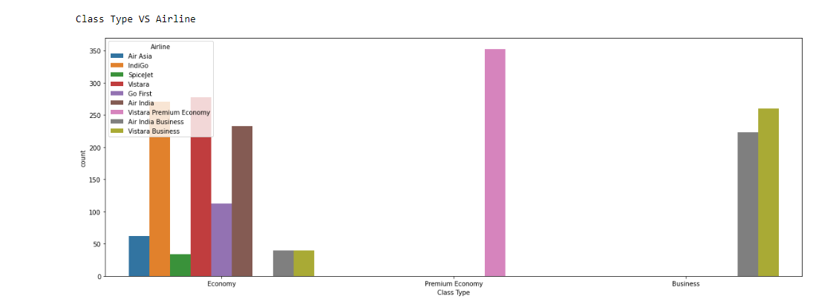
Class Type VS Airline
Vistara Premium Airlines does not offer economy or business class seats.
Air India Business and Vistara Business provide business and economy classes
Only economy class seats are available on Air Asia, Indigo, Spicejet, Vistara, Go First, and Air India

Slide 12
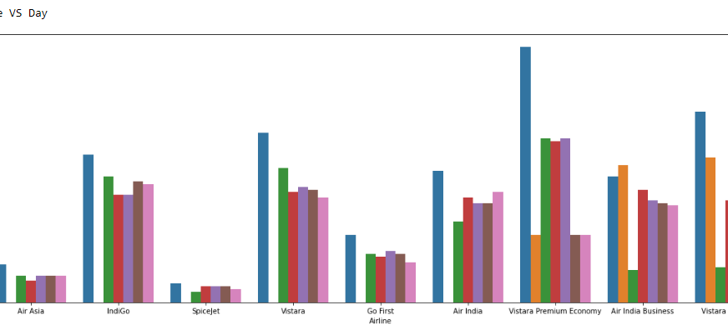
Airline VS Day
Vistara airline and Air India are most frequent flight.
Air Asia and SpiceJet has lowest flight from Mumbai to Delhi

Slide 13
Observations
Nonstop flights are less expensive than one-stop flights.
Vistara Premium Airlines does not offer economy or business class seats.
Air India Business and Vistara Business provide business and economy classes.
Sunday flight tickets are more expensive than other days.
Vistara Business and Air India Business charge higher prices in economy class than other airline companies.
Vistara Business and Air India Business are the only companies that provide business-class seats.
Next-day economy class tickets are more expensive than another day.

Slide 14
Only economy class seats are available on Air Asia, Indigo, Spicejet, Vistara, Go First, and Air India.
Only Vistara Premium Economy, Air India Business, and Vistara Business companies go from Mumbai to Delhi on Friday.
Air Asia and Spicejet have very few flights from Mumbai to Delhi.
Vistara Premium Airlines has the highest frequency among all airlines.
Air India Business, Indigo, and Vistara have very frequent flights.
All Air Asia flights are one-stop.
Indigo Airlines and Vistara Airlines have the most seats in economy class.
An airline flight ticket has no relationship between duration and price.

Slide 15
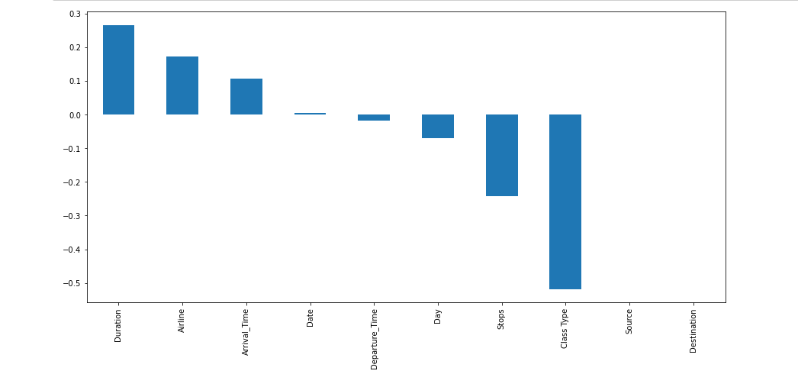
Correlation
Source and Destination has no relation with price beacuse there is only 1 source and destination
Class Type, Duration and Airline have strong relationship with Price respectively.
Date and Departure time have poor relationship with price

Slide 16
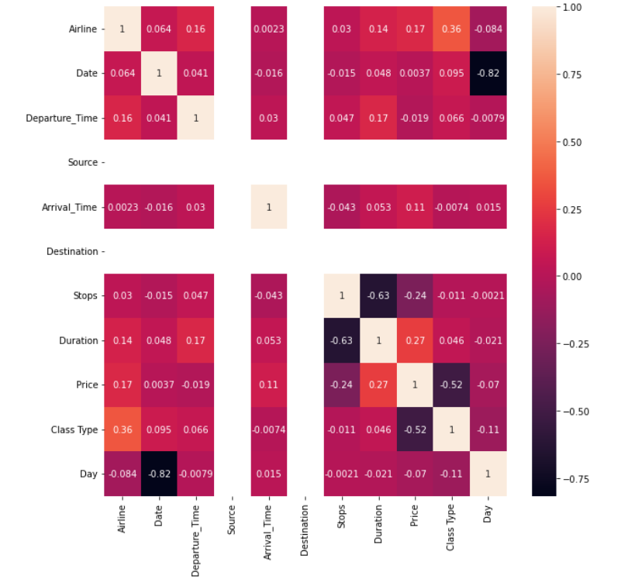
Heatmap

Slide 17
Model building steps
This problem can be solved using a regression-based machine learning algorithm.
Encoding Categorical data into Numerical data
Scaling data using Standard Scalar
Splitting data in training & test data using train_test_split from model_selection
Implementing various Regression Based Algorithm to build ML Model
Conducting 5 fold Cross validation
Hyper Parameter tuning of best Model
Saving Final Tuned Model using Joblib

Slide 18
Algorithms
Algorithm | R2 Score | CV score
Linear Regression | 44.21 | 0.27
Random Forest | 87.33 | 0.65
Decision Tree Regressor | 81.75 | 0.50
XGB Regressor | 88.19 | 0.65
SVR | -21.02 | -0.21
After Hyper parameter tuned
XGB Regressor | 88.71
Random Forest | 87.23

